Slide 1
OLIST BRAZILIAN E-COMMERCE BUSINESS INTELLIGENCE REPORT
Prepared by
George Prince Godspower

Slide 2
Executive Summary
During visual Analysis the following was observed:
At 14.98M Total Revenue has exceeded the target goal of 7.80M, similar case is seen in the other cards showing all Revenue target has been exceeded quite significantly.
Compared to last year we can see a general increase in revenue, with Electronics having the highest at 25.37% and home appliance being the lowest at 24.77.
Electronics remains the largest category by Revenue & profit while home experience a slight decline in revenue.
Saint paulo(SP) remains the region with the highest sales.
Customer acquisition has improved significantly as the CLV also improved, total customer per annum and AVO has all exceeded their target, but for the repeat purchase rate we’re yet to see a significant increase.

Slide 3
Business Objectives
The objective of this analysis for the Olist store is to know and proffer solution to the following
Identify the product performance
Identify top selling product and bottom product
Customer Lifetime Value (CLV)
Total customer per annum
Average profit per annum
Revenue Trend
Sales by Region
Gross Margin per annum
Sum of repeat customers
Returning Customers
Monthly Sales Trend
Sales And Revenue by Category
Improve lead generation efficiency
Support data-driven marketing decisions

Slide 4
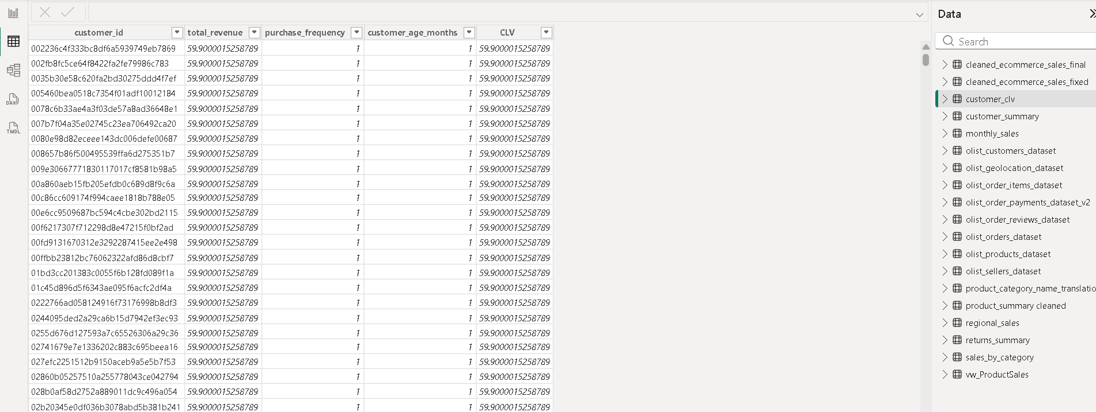
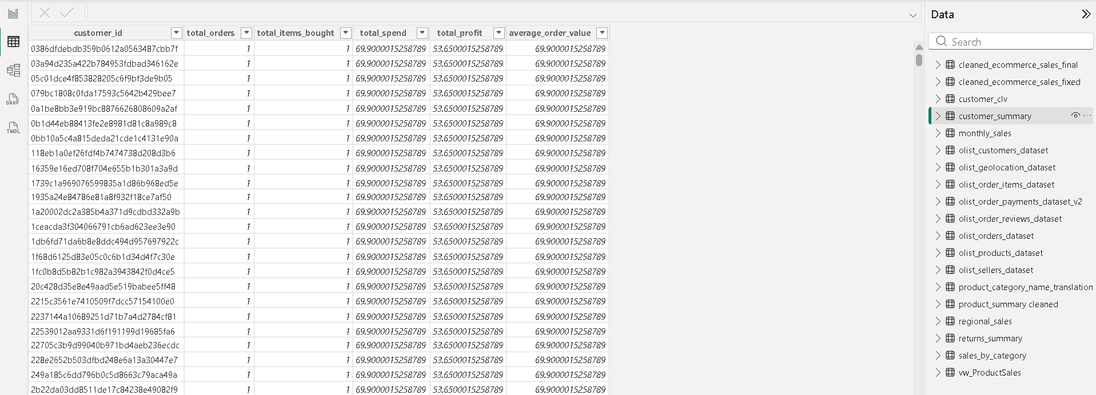
Dataset Overview
These are list of data used for the Olist analysis:
Olist customers dataset, olist geolocation dataset, olist order items dataset, olist order payments dataset,olist order reviews dataset, olist orders dataset, olist products dataset, olist sellers dataset, product category name translation, product summary, regional sales, Returns summary,Sales by category, customer clv, cleaned ecommerce sales fixed

Slide 5
Project Methodology
The methodology used to draw this meaningful insight and analysis is as follows:
The data’s been obtain was loaded on to python jupyter note book for cleaning.
The data cleaning process includes removing null values, removing duplicate values and validating data concistency.
Python was also used for EDA (e.g Data Type conversion , outlier detection, etc)
Python was also used for Feature Engineering (e.g financial features, time and calendar, CLV, etc).
SQL was used for business analysis ( e.g Top Customers (Highest Revenue), Top Products, Bottom Products, Monthly Sales Growth, ect).
Then advance analysis was done using SQL (e.g Window Functions, CTE, View, Ranking, etc).
Then Power BI was used for data visualization .

Slide 6
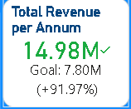
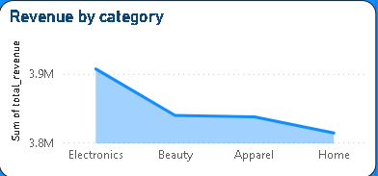
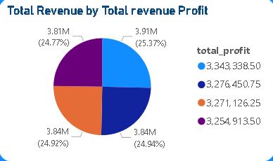
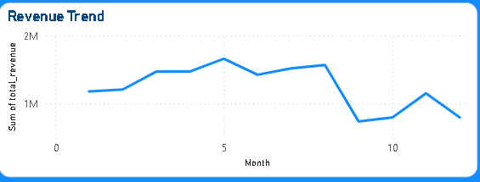
Revenue Performance
Form our Power BI dashboard we can see revenue performance and trends, Observation supported by SQL queries and Power BI dashboards.

Slide 7
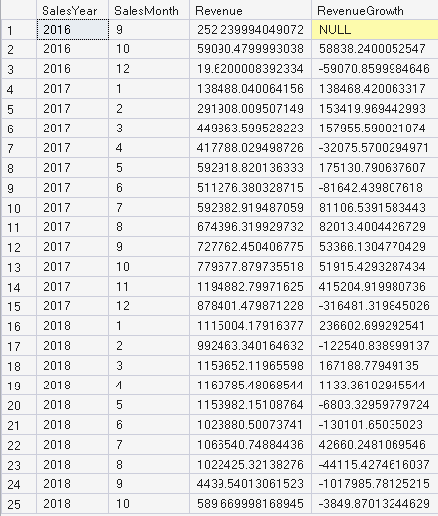
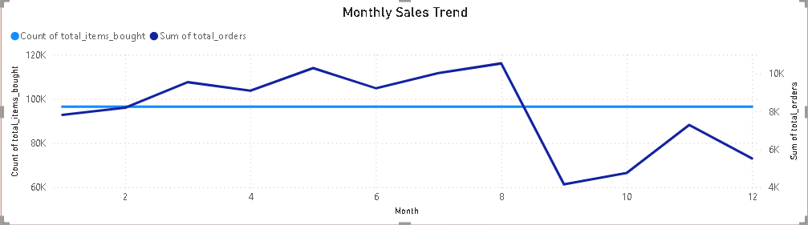
Monthly Revenue/ Sales Trend
Observation supported by SQL queries and Power BI dashboards.

Slide 8
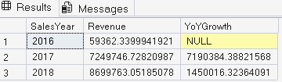
Year-over-Year Growth
Using SQL FOR business analysis we see the YoY growth we see the nearly growth doubled per year, Observation supported by SQL queries and Power BI dashboards.

Slide 9
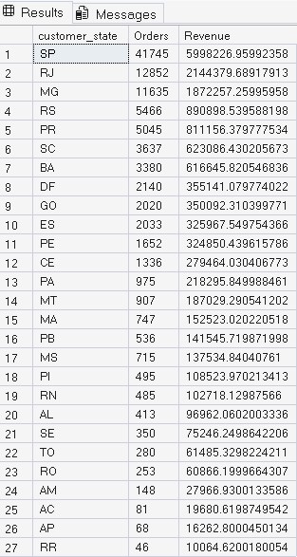
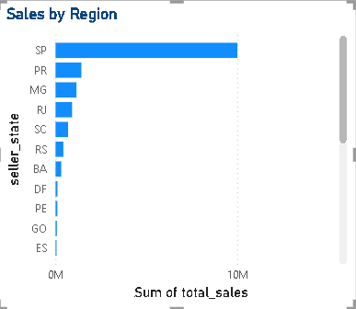
Regional Performance
After carefull analysis from both SQL and Power BI we see that SP is the region with the highest revenue and sales and others follow adeclining order as the table and chart showed , Observation supported by SQL queries and Power BI dashboards.

Slide 10
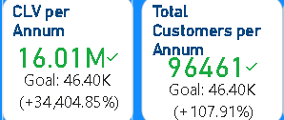
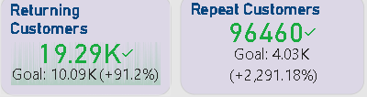

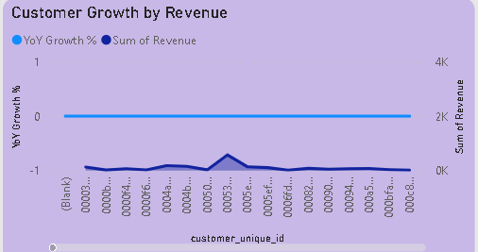
Customer Overview
The analysis from our visuals gives a clear overview of our customer performance, Observation supported by SQL queries and Power BI dashboards.

Slide 11
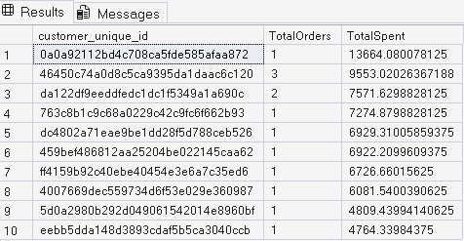
Top Customers
From my SQL analysis we can see the top customers and how much they spent, Observation supported by SQL queries and Power BI dashboards.

Slide 12
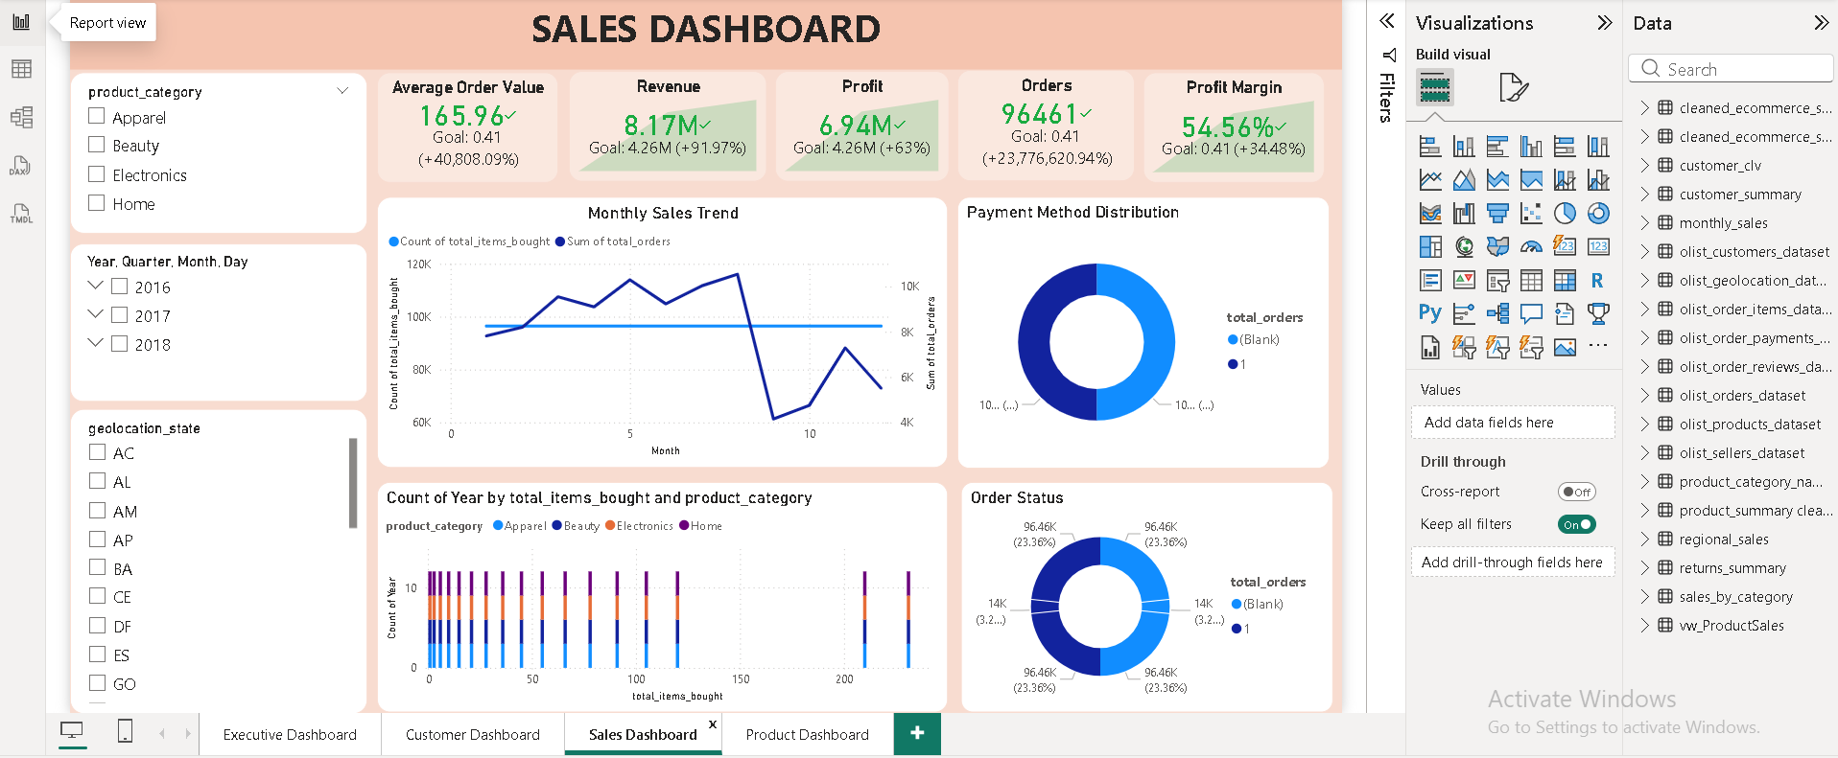
Sales Dashboard
The Observation is supported by SQL queries and Power BI dashboard analysis.

Slide 13
Sales Trends
• Observation is supported by SQL queries and Power BI dashboard analysis.

Slide 14
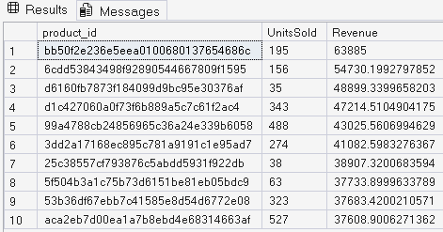
Top Products
• Observation is supported by SQL queries and Power BI dashboards.

Slide 15
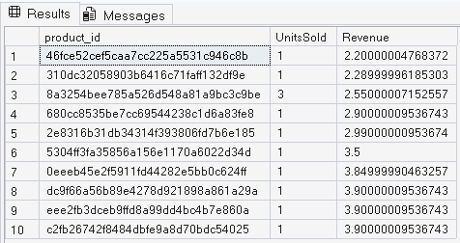
Bottom Products
From my SQL analysis we can identify the bottom product, Observation supported by SQL queries and Power BI dashboards.

Slide 16
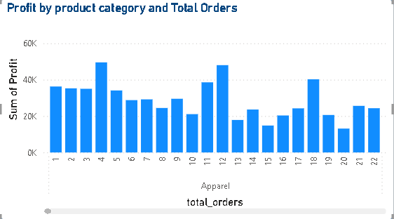
Category Performance
Observation is supported by SQL queries and Power BI dashboard analysis.

Slide 17
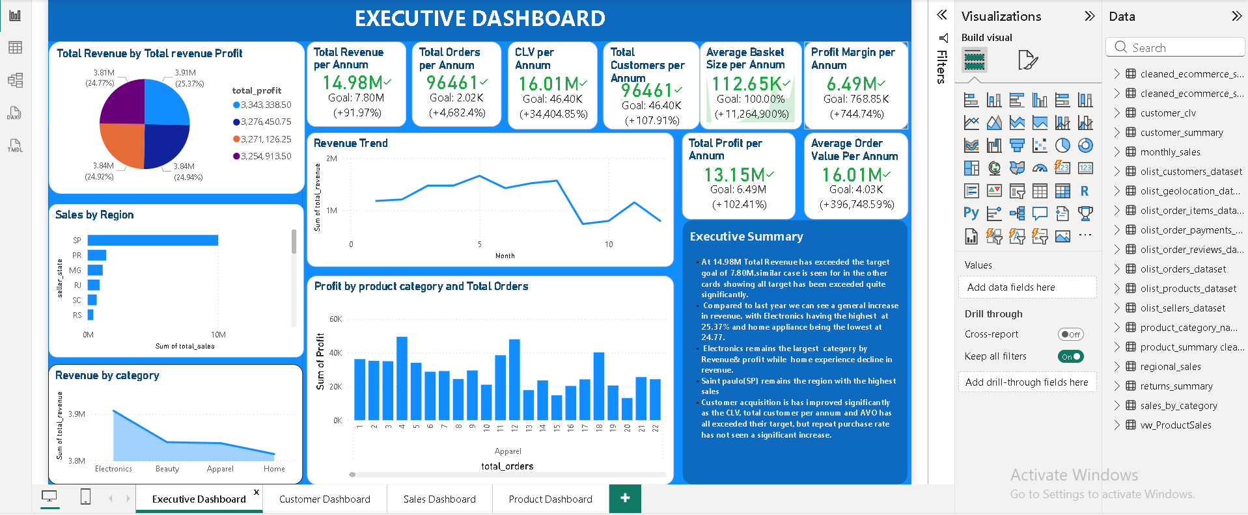
Executive Dashboard
• Observation supported by SQL queries and Power BI dashboards.
• Business implication for Olist management.
• Risks and opportunities identified.
• Actionable executive recommendation.
• Expected KPI impact and monitoring approach.

Slide 18
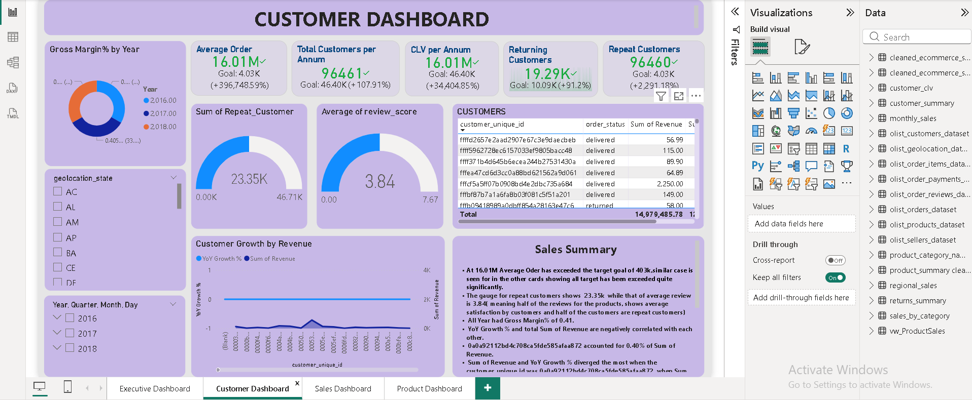
Customer Dashboard
Observation supported by SQL queries and Power BI dashboards.

Slide 19
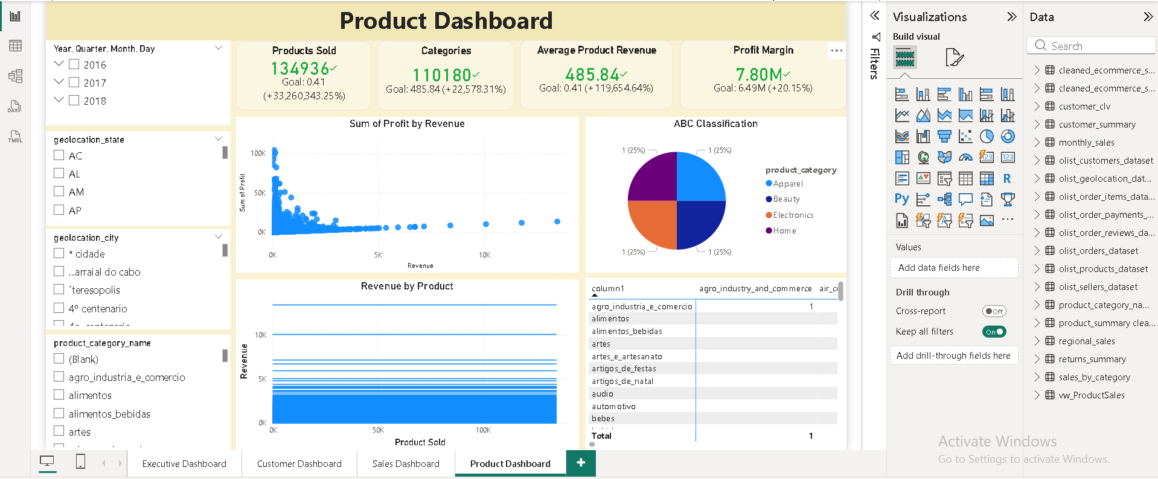
Product Dashboard
Observation is supported by SQL queries and Power BI dashboards analysis.

Slide 20
Key Business Insights & Expected Business Impact
1: Strong Revenue Growth Indicates Marketplace Expansion(The analysis reveals that Olist experienced significant revenue growth between 2016 and 2018, with 2017 serving as the turning point for business expansion.)
Business Impact
Demonstrates increasing customer confidence.
Indicates effective marketplace penetration.
Provides a strong foundation for future growth strategies.
2: Revenue is Highly Concentrated in a Few States(Regional performance analysis shows that São Paulo (SP) consistently generated the highest revenue, followed by Rio de Janeiro (RJ) and Minas Gerais (MG). These three states account for a substantial proportion of total marketplace sales.)
Business Impact
Existing marketing efforts are effective in major economic regions.
Geographic revenue concentration increases business risk.
Expansion into underperforming regions presents significant growth opportunities.

Slide 21
Key Business Insights & Expected Business Impact
3: Product Sales Follow the Pareto Principle:
Product analysis indicates that a relatively small number of products generate the majority of marketplace revenue, while many products contribute minimally to total sales.This pattern reflects the Pareto Principle (80/20 Rule), where approximately 20% of products drive most business value.
Business Impact
Inventory investment should prioritize high-performing products.
Low-performing products require optimization or discontinuation.
Product portfolio management can significantly improve profitability.
4: Customer Acquisition is Strong, but Customer Retention Needs Improvement
Although Olist continues to attract new customers, repeat customer analysis indicates that customer retention remains relatively low. This suggests customers purchase once but do not consistently return to the platform.
Business Impact
High customer acquisition costs.
Lower Customer Lifetime Value (CLV).
Missed opportunities for recurring revenue.

Slide 22
Key Business Insights & Expected Business Impact
5: Customer Purchasing Behavior Shows Seasonal Trends
Monthly sales growth demonstrates seasonal purchasing patterns, with peak transaction periods occurring during promotional events and holiday seasons. Understanding these trends enables better inventory planning and marketing campaign scheduling.
Business Impact
Improved inventory forecasting.
Better promotional planning.
Reduced stock shortages.
6: A Small Number of Customers Generate Significant Revenue
Top customer analysis reveals that a relatively small customer segment contributes disproportionately to overall revenue. These customers represent high-value business assets.
Business Impact
High-value customers should receive personalized engagement.
Customer loyalty initiatives should focus on premium customers.
VIP customer programs can increase retention.

Slide 23
Strategic Recommendations
1: Develop a Customer Loyalty Program
Introduce a tiered customer loyalty program that rewards repeat purchases through discounts, reward points, exclusive promotions, and personalized offers.
Expected Outcome
Increased repeat purchase rate
Higher Customer Lifetime Value
Improved customer retention
2: Expand Marketing into Emerging Regions
While São Paulo dominates sales, additional investment should target underperforming states through localized digital marketing campaigns.
Expected Outcome
Geographic revenue diversification
Increased customer acquisition
Reduced dependence on one region

Slide 24
Strategic Recommendations
Strategic Recommendations
3: Optimize Product Portfolio
Increase inventory levels for top-selling products while reviewing low-performing products for bundling, discounting, or discontinuation.
Expected Outcome
Improved inventory turnover
Reduced storage costs
Higher profitability
4: Implement Customer Segmentation
Leverage customer purchasing history to create personalized marketing campaigns based on buying behavior.
Suggested segments include:
New Customers
Repeat Customers
High-Value Customers
Dormant Customers
Expected Outcome
Improved marketing ROI , Higher conversion rates , Better customer engagement

Slide 25
Strategic Recommendations
Strategic Recommendations
5: Improve Demand Forecasting
Use historical sales data and seasonal trends identified during Python EDA and SQL analysis to forecast future product demand.
Expected Outcome
Lower stock-outs
Reduced excess inventory
Better supply chain planning

Slide 26
Business impact
Business Area | Expected Impact
Revenue Growth | Higher sales through improved customer retention and regional expansion
Customer Retention | Increased repeat purchases and stronger customer loyalty
Inventory Management | Better stock planning and reduced inventory costs
Marketing Performance | Higher ROI through targeted campaigns and customer segmentation
Regional Expansion | Diversified revenue across more Brazilian states
Decision Making | Faster and more informed decisions using Power BI dashboards
Operational Efficiency | Reduced manual reporting through Python automation and SQL reporting
Customer Experience | Personalized shopping experience leading to increased satisfaction

Slide 27
Long-Term Business Benefits
Sustainable revenue growth
Increased market share
Higher customer lifetime value
Improved profitability
Better resource allocation
Enhanced operational efficiency
Data-driven strategic decision-making

Slide 28
Conclusion
This project demonstrates how integrating Python, SQL, and Power BI can transform raw e-commerce data into actionable business intelligence.
Python was instrumental in preparing the data by performing cleaning, handling missing values, removing duplicates, engineering features, and conducting exploratory data analysis to ensure a reliable analytical foundation. SQL then enabled detailed business analysis by uncovering revenue trends, regional performance, customer purchasing behavior, and product performance. Finally, Power BI translated these analytical findings into interactive dashboards that support executive decision-making through real-time KPI monitoring and intuitive visualizations.
The analysis identified several strategic opportunities, including strengthening customer retention, optimizing the product portfolio, expanding into underperforming regions, and enhancing demand forecasting. By implementing the recommended strategies, Olist can improve customer lifetime value, diversify revenue streams, increase operational efficiency, and support long-term, data-driven growth.
This end-to-end analytics workflow highlights the value of combining Python for data preparation and exploration, SQL for business intelligence, and Power BI for executive reporting, providing a scalable framework for informed decision-making and sustained competitive advantage in the Brazilian e-commerce market.

